Slide 1
Productivity Funding update
Beth Stewart, Senior policy analyst

Slide 2
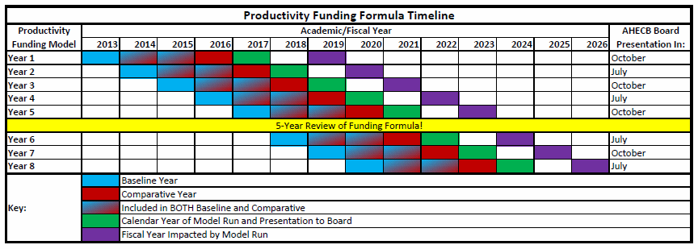
Where are we on the timeline?

Slide 3
Year 5 of productivity
May/June – Preliminary Run of Metrics
June/July – Data review and Clean-up
July – Second Run of Metrics to Confirm Data Clean-up (if needed)
July 30th – DEADLINE for data clean-up.
August – Final Run of Metrics
September 1st – Productivity Scores Released
September 1st-September 15th – Two week dead period
September 15th – Distribution presented to Governor’s Office
September 22nd – Approved Distribution sent to Presidents and Chancellors
October – Presented at AHECB Meeting

Slide 4
What to do with the spreadsheets you receive?
Download from FT server ASAP! They delete within 30 days.
Treat the files securely. They contain FERPA protected information.
Review for errors
Human Errors – Does the spreadsheet appear formatted correctly? Are all of the years included? Are the right years included? Is it for your institution?
Reporting Errors – Does the data match what you show in your system? Does the data match the IDB?
Do you understand how the metrics are being run?
Share with administration

Slide 5
What to do if you find an issue?
Contact Beth Stewart – beth.stewart@adhe.edu or 501-371-2058 – For any issues found.
Is the because of a data reporting issue? Example: student had race reported incorrectly.
If the issue is due to an invalid SSN or an invalid grade, submit the appropriate GUP or ChangeID file.
If the issue is due to an error in a file, contact Rachel Lewis regarding resubmissions.
All updates must be made by July 30th!
Once Distribution is released there are NO corrections made.

Slide 6
5 Year productivity review
Review conducted by Productivity Funding Workgroup
Two year, four year, system, non-system representatives included.
Presidents/Chancellors, IR Directors, and CFOs included.
STEM and High Demand List Review
Is there something in the model you think should be changed?
Speak with your administration.
Email Director Markham and Beth Stewart.
Timeline – Anticipate making recommendations for change by end of AY22.

Slide 7
Campus Visits
Open invitation but not required.
Email Beth Stewart to schedule a date.
Who should consider a Productivity Campus Visit?
New administration
New IR team
Anyone wanting additional training for their campus

Slide 8
Beth Stewart Sr. Policy Analyst beth.stewart@adhe.edu (501)371-2058

